Slide 1

Databases Project II SoccerStats Football Statistics
Students: Salvatore Froncillo 0522500858
Eugenio Albano 0522500741
Notes:
I dealt with the project concerning the Gender Classification with the use of the spider web.

Slide 2
Summary
The idea
Types of Research
NoSQL
Dataset Used
Implementation
Demo
Notes:
The presentation is structured as follows:
First of all, the project will be briefly introduced, analyzing the objectives and the dataset used.
Later we will focus on the image preprocessing phase , focusing on the differences between the algorithm delivered to us and our final version.
We will continue with the analysis of the classifiers designed and trained, showing the results obtained.
conclude with some further evidence and final considerations.

Slide 3
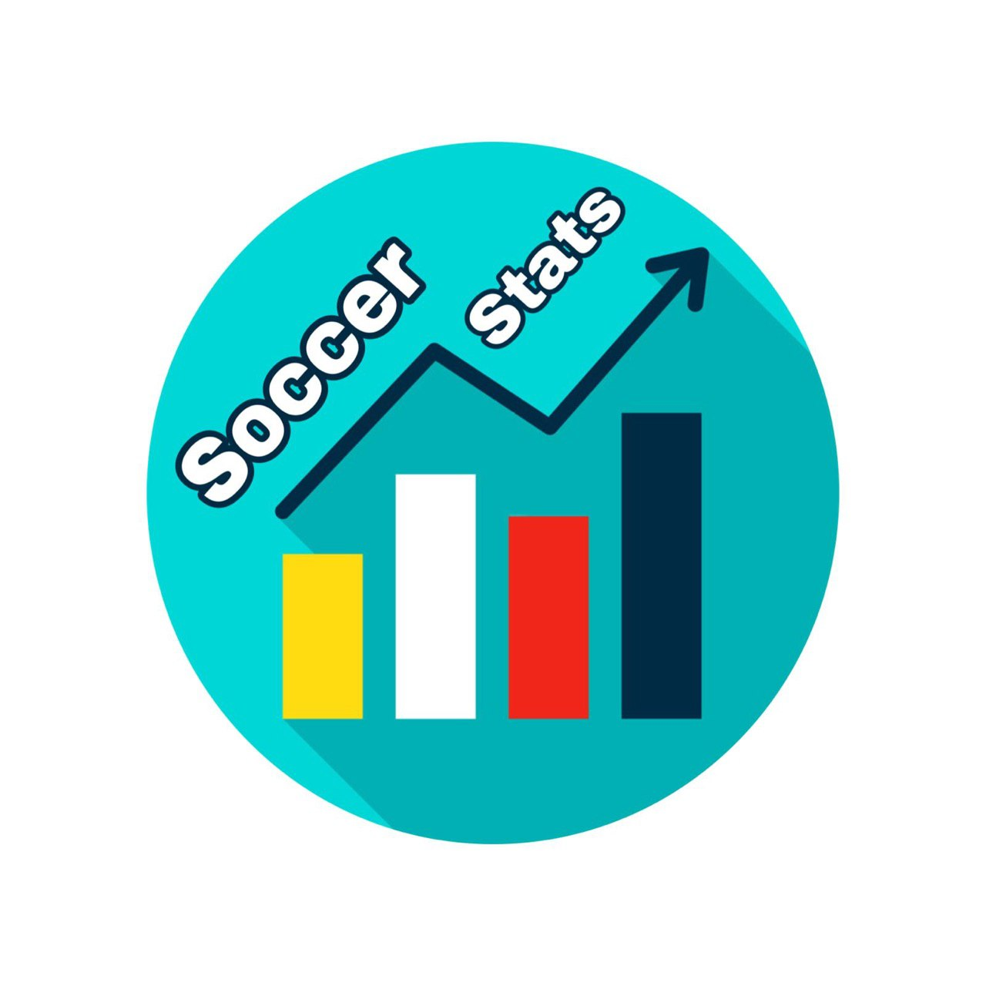
The idea
standalone desktop application to search for more precise and personalized statistics on the skills of players and to carry out technical analyzes
Find a dataset that allows us to evaluate the player's skills
Creation of different search modes
Notes:
Our project aims to solve the problem of gender classification with a good degree of accuracy by using only the landmarks of the face.
The idea is to apply a spider web with a fixed number of sectors to the face with the landmarks , as we can see from the image,
and derive a vector that keeps track of the number of landmarks that fall in each sector.
The dataset that we will give as input to the classifier will therefore be composed only of the "spider web" vectors.
Finally, the trained classifier will have to return a value that indicates the gender of the individual.

Slide 4
First Research
Second Research
The first type of research is the most specific. It involves searching for a single player by name.
The second type of search includes various search parameters, including:
Nationality
Age Range
Overall
Role
Notes:
Now let's introduce the 3 research modes devised:
The first search is the more specific one, based on the precise search for the name.
Then we have the second search, which provides for the setting of a maximum of 6 search parameters, i.e. nationality, age range , Overall range (with overall intended as player skill), role.

Slide 5
Third Research
The last method of research involves a demographic comparison between 3 nationalities in a given age range .
Notes:
The last method of research involves a demographic comparison between 3 nationalities, in a certain age range . We can note on the x-axis the age of the players, and on the ordinate axis the number of players of that age for each nation.

Slide 6
NoSQL
MongoDB
Over the last few years, the approach with NoSQL technologies is spreading rapidly. One of the most used NoSQL databases is MongoDB .
MongoDB allows information to be represented in data structures called documents , which are conceptually similar to objects.
The documents are grouped into collections , even heterogeneous; this is possible since document-based NoSQL DBs are schemaless .
The main features of MongoDB are:
High availability through automatic Sharding
Handling of large amounts of data
Scalability
Notes:
As for the choice of the NoSql Database , we opted for MongoDB . It allows information to be represented in data structures called documents , which are conceptually similar to objects. Documents are grouped into collections. This is possible since being a NoSqul database it is based on schemaless documents .
Among the main features we find: the ability to manage large amounts of data, scalability and high availability through automatic Sharding .

Slide 7
Dataset Used
FIFA 19 complete player dataset
The Dataset consists of:
about 18,000 records
80+ Attributes including:
Nationality
Age
Technical attributes of the football player
https://www.kaggle.com/karangadiya/fifa19
Notes:
Let's now analyze the dataset used. We needed as large a dataset as possible regarding the variety and number of players, and the dataset of the most popular football game: FIFA was considered.
It is made up of more than 18k records, and each record is made up of more than 80 attributes regarding technical attributes, personal data, and other statistics on the individual player.

Slide 8
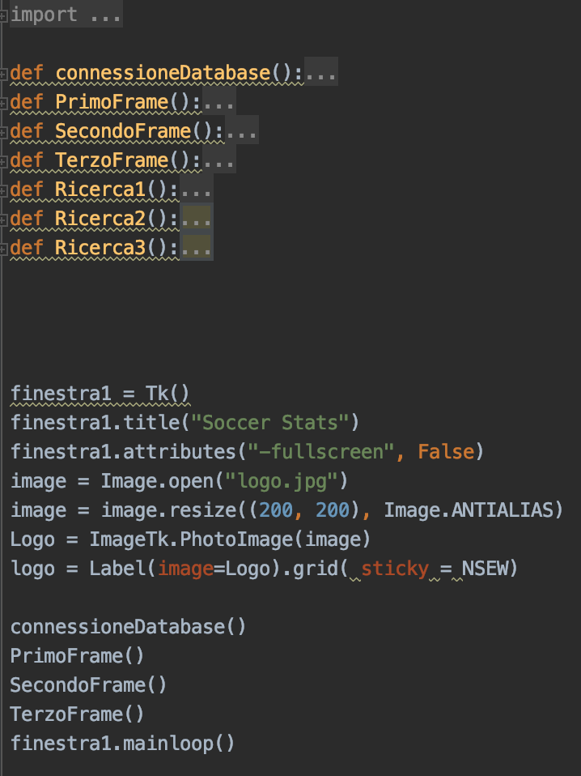
Implementation - Part 1
Project Structure
The project is structured in 3 parts:
Connection to the Database
Graphic interface
Query with graphical implementation of the results
Notes:
Our project is mainly structured in 3 parts:
The connection to the database, the graphical interface, which costs 3 functions, 1 for each search frame, and 3 functions that graphically implement the 3 search queries, which we will analyze more. Deep. shortly . _

Slide 9
Implementation - Part 2
Graphic interface
The following libraries were mainly used for the graphical interface:
Pandas , for data manipulation and analysis
Matplotlib , for creating graphs
Tkinter, for the actual creation of the graphic interface of the application
Tkinter
Notes:
The GUI was built using pandas

Slide 10
Implementation - Part 3
Query
For the Query test we used the official MongoDB tool , Compass .
The developed queries are 3:
Search for a single record
Search for a subset of records
Search for a set of records with aggregation
Notes:
Despite using the previous function, approximately 1% of images are discarded. Analyzing the discarded images, we found different types of impurities, including: partially covered faces, images with only eyes, objects not inherent to faces and sometimes images labeled incorrectly. The latter are identified during the extraction phase of the Features from the file name and immediately discarded.

Slide 11
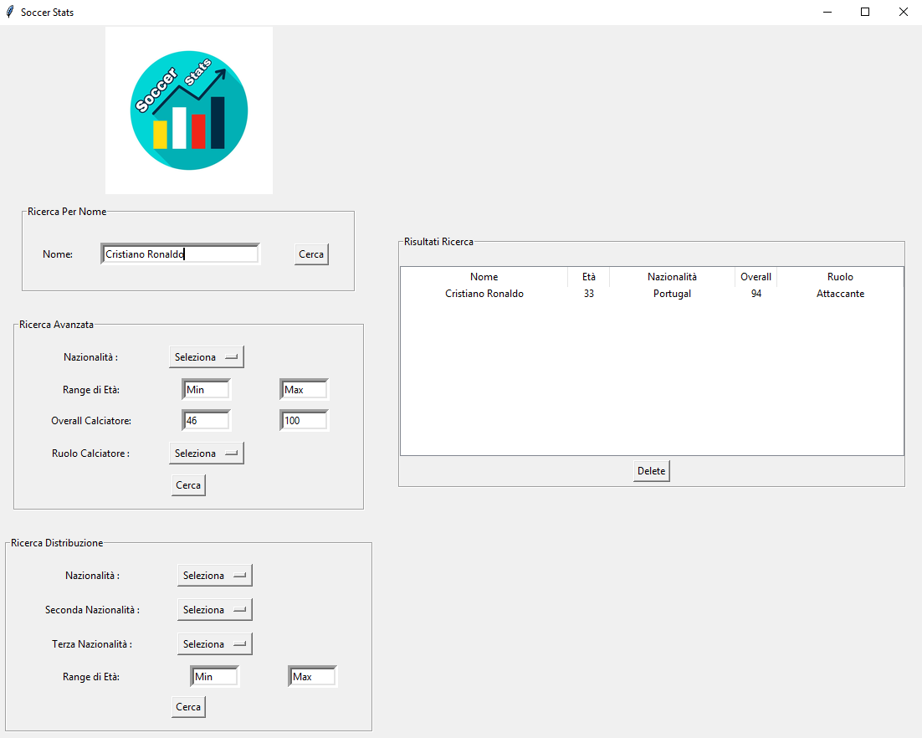
Query 1: Search by Name
toSearch = input_frame1_1.get () query_frame1 = {} query_frame1 [ "Name" ] = toSearch result_list = [] OutputQuery = list ( collection.find (query_frame1 , { "_id" : 0 , "Name" : 1 , " Nationality " : 1 , "Age" : 1 , " Overall " : 1 , "Position" : 1 }))
Notes:
We then developed a second model that uses a neural network.
Therefore, for each image we have an array of integers with a variable size based on the chosen configuration. The network is made up of two hidden layer with a size of 256 neurons and a single output value that expresses the probability of the element to belong or not to a genus.

Slide 12
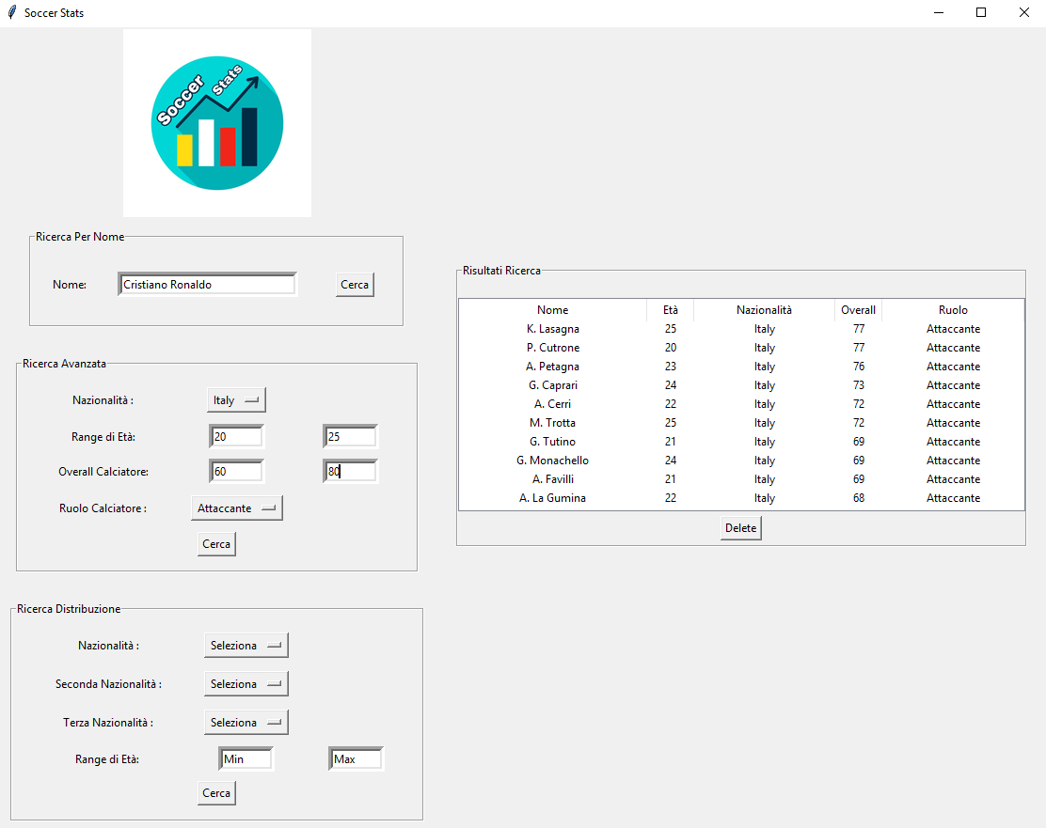
Query 2: Advanced Search
query1 = {} if flag_nationality == 1 : query1 [ " Nationality " ] = tryAssign0 if flag_eta_min == 1 and flag_eta_max == 0 : age = {} age [ "$ gte " ] = input_frame2_2.get () query1 [ "Age" ] = age if flag_eta_max == 1 and flag_eta_min == 0 : age = {} age [ "$ lte " ] = input_frame2_3.get () query1 [ "Age" ] = age if flag_eta_min == 1 and flag_eta_max == 1 : age = {} age [ "$ gte " ] = input_frame2_2.get () age [ "$ lte " ] = input_frame2_3.get () query1 [ "Age" ] = age if flag_overall_min == 1 and flag_overall_max == 0 : overall = {} overall [ "$ gte " ] = input_frame2_4.get () query1 [ " Overall " ] = overall if flag_overall_max == 1 and flag_overall_min == 0 : overall = {} overall [ "$ lte " ] = input_frame2_5.get () query1 [ " Overall " ] = overall if flag_overall_max == 1 and flag_overall_min == 1 : overall = {} overall [ "$ gte " ] = input_frame2_4.get () overall [ "$ lte " ] = input_frame2_5.get () query1 [ " Overall " ] = overall if role_flag == 1 : query1 [ "Position" ] = tryAssign1 OutputQuery = list ( collection.find (query1 , { "_id" : 0 , "Name" : 1 , " Nationality " : 1 , "Age" : 1 , " Overall " : 1 , "Position" : 1 }))
Notes:
We then developed a second model that uses a neural network.
Therefore, for each image we have an array of integers with a variable size based on the chosen configuration. The network is made up of two hidden layer with a size of 256 neurons and a single output value that expresses the probability of the element to belong or not to a genus.

Slide 13
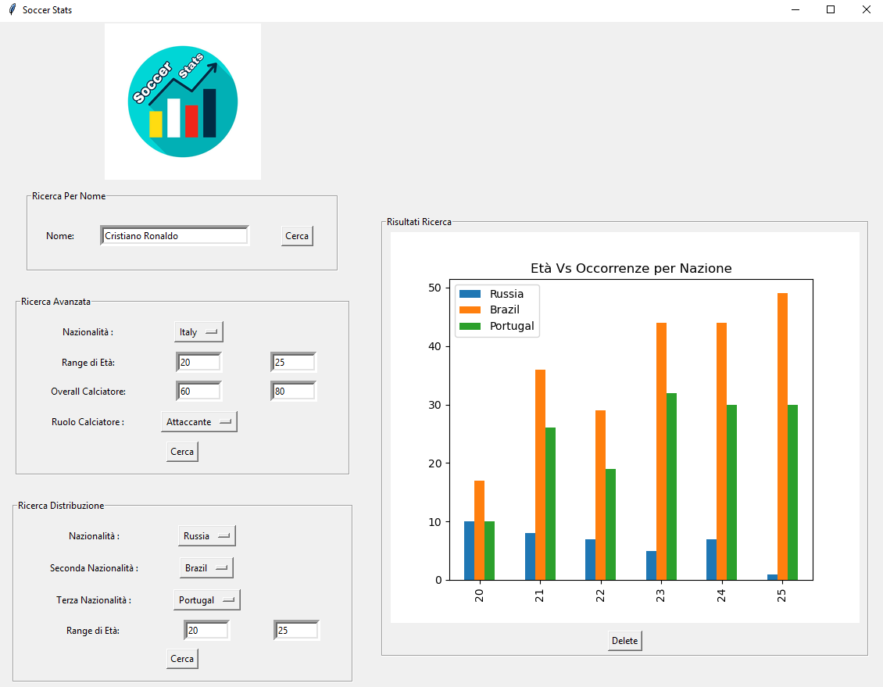
Query 3: Search Distribution
pipeline1 = [{ "$ match" : { " Nationality " : nationality_distribution1 , "Age" : { "$ gte " : input_frame3_4.get () , "$ lte " : input_frame3_5.get ()}}} , { "$ group" : { "_id" : "$ Age" , " count " : { "$ sum" : 1 }}} , { "$ sort " : { "_id" : 1 }}] pipeline2 = [{ "$ match" : { " Nationality " : nationality_distribution2 , "Age" : { "$ gte " : input_frame3_4.get () , "$ lte " : input_frame3_5.get ()}}} , { "$ group" : { "_id" : "$ Age" , " count " : { "$ sum" : 1 }}} , { "$ sort " : { "_id" : 1 }}] pipeline3 = [{ "$ match" : { " Nationality " : nationality_distribution3 , "Age" : { "$ gte " : input_frame3_4.get () , "$ lte " : input_frame3_5.get ()}}} , { "$ group" : { "_id" : "$ Age" , " count " : { "$ sum" : 1 }}} , { "$ sort " : { "_id" : 1 }}] resultsAggregate1 = list ( collection.aggregate (pipeline1)) resultsAggregate2 = list ( collection.aggregate (pipeline2)) resultsAggregate3 = list ( collection.aggregate (pipeline3))
Notes:
We then developed a second model that uses a neural network.
Therefore, for each image we have an array of integers with a variable size based on the chosen configuration. The network is made up of two hidden layer with a size of 256 neurons and a single output value that expresses the probability of the element to belong or not to a genus.

Slide 14
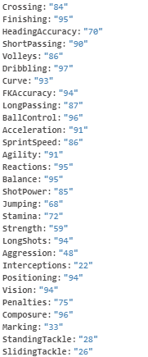
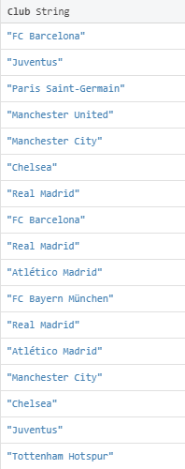
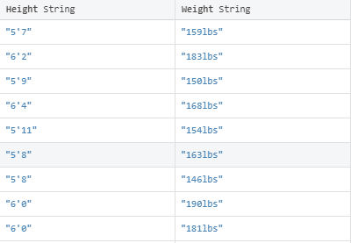
Future developments
The development of this project took into consideration only a minimal section of the dataset (5 attributes out of 88), so it is possible to easily expand the number of statistics and graphs with small code updates.
Notes:
At this point an attempt was made to highlight a possible contribution of the web dataset in a hybrid network. A hybrid neural network was therefore implemented. Taking up the convolutional neural network of the previous classifier, arrived at the phase following the flattening , in which the layers are fully connected , we have concatenated the data coming from the spider web dataset to this layer and inserted them in input to a further 2 layers fully connected , to then obtain the single output.

